Slide 1
Representing Information
IT 301

Slide 2

Binary numbers
Computers store data values as sequences of ones and zeroes called binary numbers
Numbers
Text
Images
Audio/video

Slide 3


Number bases
Binary numbers are base 2 whereas decimal are base 10
The base of a number determines the value a digit can have
Decimal
Binary
How many options
do we have per
digit?

Slide 4
Terminology
Bit: a single binary digit
100
Byte: a binary number with eight bits
00010101
11011000
A bit that is one is called “on” or “set”
A bit that is zero is called “off” or “unset”

Slide 5
Terminology
It can be useful to think of binary numbers as arrays of bits
Each bit has an index
The indices should be reversed though!
Computer/hardware architecture
Word: a unit of data that is processed by a certain processor
Contains instructions to execute
Word size: the number of bits in a word
Typically 32-bit, or 64-bit
Fixed size!

Slide 6
Properties of binary numbers
A binary number with n bits can store 2^{n} values
Unsigned numbers
Positive numbers and zero
Signed numbers
Positive numbers, negative numbers and zero
Bits | Possible values
8 bits (byte) | 256
32 bits | 4294967296
64 bits | 18446744073709551616 (18 x )

Slide 7
Interpreting binary numbers
A number (of any base) is a sum of powers of the base
Decimal example:
169 = 1x10² + 6x10¹ + 9x10⁰
169 = 100 + 60 + 9
Another decimal example:
1077 = 1x10³ + 0x10² + 7x10¹ + 7x10⁰
1077 = 1000 + 0 + 70 + 7
Binary example:
1011 = 1x2³ + 0x2² + 1x2¹ + 1x2⁰
1011 = 8 + 0 + 2 + 1

Slide 8
Base subscript
Be careful!
1011 in binary is not the same as 1011 in decimal
What does the following equality depict?
1011 = 8 + 0 + 2 + 1 = 11
Denote the base using subscript
1011₂ = 8 + 0 + 2 + 1 = 11₁₀

Slide 9


Binary to decimal conversion
Convert from binary to decimal with the following table
What does 00011001 represent?
00011001₂ = 16 + 8 + 1 = 25

Slide 10
Practice!
Finish the following table
Binary number | Decimal equivalent
00000011
00100001
00001111
00110110
01111111
Binary number | Decimal equivalent
00000011 | 3
00100001 | 33
00001111 | 15
00110110 | 54
01111111 | 127

Slide 11

Terminology
Terminology
Significant bits
Most significant bit (MSB): the bit with the highest numerical value
Least significant bit (LSB): the bit with the lowest numerical value
MSB
LSB

Slide 12
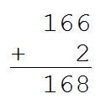
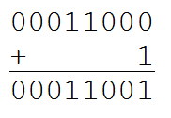
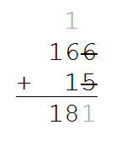
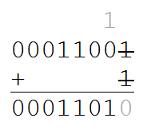
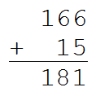
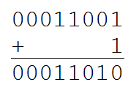
Binary addition
Similar to decimal arithmetic
carry
remaining part

Slide 13
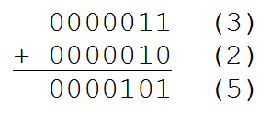
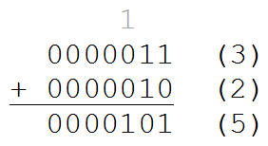
Binary addition
carries

Slide 14
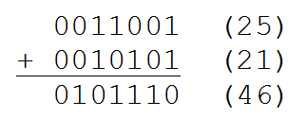
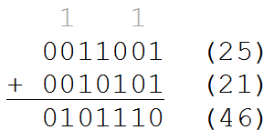
Binary addition
carries

Slide 15
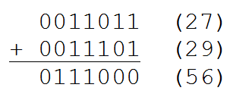
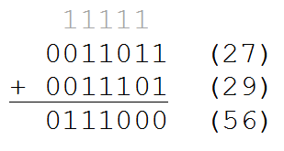
Binary addition
carries

Slide 16
First positive binary numbers
Decimal | Binary | Decimal | Binary
1 | 00000001 | 11 | 00001011
2 | 00000010 | 12 | 00001100
3 | 00000011 | 13 | 00001101
4 | 00000100 | 14 | 00001110
5 | 00000101 | 15 | 00001111
6 | 00000110 | 16 | 00010000
7 | 00000111 | 17 | 00010001
8 | 00001000 | 18 | 00010010
9 | 00001001 | 19 | 00010011
10 | 00001010 | 20 | 00010100

Slide 17
Decimal to binary conversion
Convert 77 to 01000111
Reduction algorithm
Steps:
Determine the largest i for which 2^{i} is less than or equal to your number
Mark the ith binary digit as one
Reduce your number by 2^{i}
Continue with steps 1-3 until your remaining number is zero

Slide 18
Reduction algorithm
The index for each bit is listed in the exponents below
Convert 77 to 01001101
Decimal number | Largest 2^{i} | Binary number | Reduce number
77 | 64 = 2⁶ | 01000000 | 77 – 64 = 13
13 | 8 =2³ | 01001000 | 13 – 8 = 5
5 | 4 = 2² | 01001100 | 5 – 4 = 1
1 | 1 = 2⁰ | 01001101 | 1 – 1 = 0
0 (stop!)
Answer!

Slide 19
Decimal to binary conversion
Division algorithm
Steps
Divide your number by two
The remainder of this division will be the least significant digit (rightmost)
Continue with steps 1-2 until your number is zero. Each remainder will be the binary digit of your result from right to left.

Slide 20
Division algorithm
Convert 77 to 01001101
Decimal number | Remainder | Binary number | Divide by two
77 | 1 | 1 | 77 / 2 = 38
38 | 0 | 01 | 38 / 2 = 19
19 | 1 | 101 | 19 / 2 = 9
9 | 1 | 1101 | 9 / 2 = 4
4 | 0 | 01101 | 4 / 2 = 2
2 | 0 | 001101 | 2 / 2 = 1
1 | 1 | 1001101 | 1 / 2 = 0 (stop!)
 |  | 01001101
Answer!

Slide 21
Twos complement
Ones complement integers
Obtained by inverting all the bits in a binary number
Can represent
2^{n-1}-1 positive numbers
Positive zero, negative zero (!!!)
2^{n-1}-1 negative numbers
Twos complement integers
Can represent
2^{n-1}-1 positive numbers
Zero
2^{n-1} negative numbers

Slide 22
Twos complement
Leading bit
Positive numbers always have a zero in the MSB
Negative numbers always have a one in the MSB
Representing a negative value (-7)
Calculate the positive binary version of the number
00000111₂ = 7
Invert all bits
11111000
Add 1
11111001₂ = -7

Slide 23
Practice!
Finish the following table
Decimal number | Binary number | Invert bits | Binary equivalent
-1
-4
-43
-127
0
Decimal number | Binary number | Invert bits | Binary equivalent
-1 | 00000001 | 11111110 | 11111110 + 1 11111111
-4
-43
-127
0
Decimal number | Binary number | Invert bits | Binary equivalent
-1 | 00000001 | 11111110 | 11111110 + 1 11111111
-4 | 00000100 | 11111011 | 11111011 + 1 11111100
-43 | 00101011 | 11010100 | 11010100 + 1 11010101
-127 | 01111111 | 10000000 | 10000000 + 1 10000001
0 | 00000000 | 11111111 | 11111111 + 1 00000000

Slide 24
Practice!
Finish the following table
Binary number | Decimal number | Invert bits | Binary equivalent
11111011
11101000
10011111
10000000
Binary number | Decimal number | Invert bits | Binary equivalent
11111011 | -5 | 00000100 | 00000100 + 1 00000101
11101000
10011111
10000000
Binary number | Decimal number | Invert bits | Binary equivalent
11111011 | -5 | 00000100 | 00000100 + 1 00000101
11101000 | -24 | 00010111 | 00010111 + 1 00011000
10011111 | -97 | 01100000 | 01100000 + 1 01100001
10000000 | -128 | 01111111 | 01111111 + 1 10000000

Slide 25
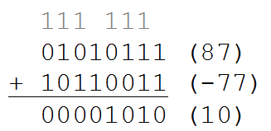
Subtracting twos complement numbers
To subtract two numbers, you add a negative number
87-77 in binary
01010111₂ = 87
01001101₂ = 77
10110011₂ = -77

Slide 26
Practice!
Finish the following table
Expression | Binary values | Convert to negative | Result
4 - 2
14 – 8
71 - 43
12 – 21
Expression | Binary values | Convert to negative | Result
4 - 2 | 00000100 = 4 00000010 = 2 | 11111101 + 1 11111110 | 00000100 +11111110 00000010
14 – 8
71 - 43
12 – 21
Expression | Binary values | Convert to negative | Result
4 - 2 | 00000100 = 4 00000010 = 2 | 11111101 + 1 11111110 | 00000100 +11111110 00000010
14 – 8 | 00001110 = 14 00001000 = 8 | 11110111 + 1 11111000 | 00001110 +11111000 00000110
71 - 43 | 01000111 = 71 00101011 = 43 | 11010100 + 1 11010101 | 01000111 +11010101 00011100
12 – 21 | 00001100 = 12 00010101 = 21 | 11101010 + 1 11101011 | 00001100 +11101011 11110111

Slide 27
Integer overflow
Any numerical value has a finite range
Java primitives:
Primitive | Bits | Min | Max | Total numbers
byte | 8 | -128 | 127 | 256
short | 16 | -32768 | 32767 | 65536
int | 32 | -2147483648 | 2147483647 | 4294967296
long | 64 | 2⁶³ | 2⁶³-1 | 2⁶⁴
float | 32 | ±1.45x10⁻⁴⁵ | ±3.4x10³⁸ | --
double | 64 | ±4.94x10⁻³²⁴ | ±1.79x10³⁰⁸ | --

Slide 28
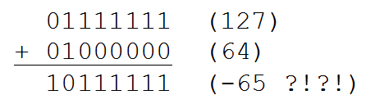
Integer overflow
Numeric operations that exceed the bounds of a numeric type result in meaningless results
Note: byte range is -128 to 127
Detecting overflow
Look for the sign of your result changing incorrectly

Slide 29
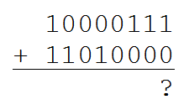
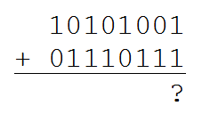

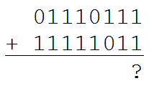
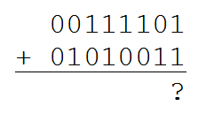
Practice!
Which of the following result in overflow?

Slide 30
Hexadecimal
Properties
Base 16
Digits 0-9, A-F
A = 10, B = 11, C = 12, D = 13, E =14, F = 15
Notations
Typical
#C01, #FF4D4D, #A379B
Java
0x11AF3E, 0xDEA100, 0xC14
Used to summarize large binary strings
RGBA color values, web colors
IPv6 web addressing

Slide 31
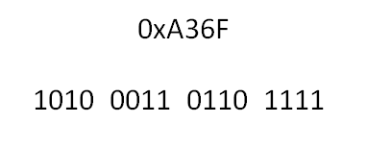
Conversion hexadecimal ←→binary
Each hexadecimal digit is converted to four binary bits
Note: A = 10, B = 11, C = 12, D = 13, E = 14, F = 15

Slide 32

Octal
Properties
Base 8
Digits 0-7
Notation
Java (begins with a leading zero):
056, 013, 077
Conversion octal ← → binary

Slide 33
Bitwise operations
Java has operators which manipulate and access the bits in integral data types
Why use these operators?
You can track more information than just the sum of the bit values of a number
Operators
Operator | Notation
Complement | ~
AND, OR, XOR | &, |, ^
Bit shift left, right | <<, >>
Unsigned bit shift right | >>>

Slide 34
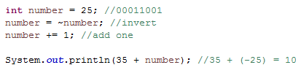
Complement operator
Bitwise complement
Unary operator (one operand)
Inverts the bits in a number
00010110 → 11101001

Slide 35
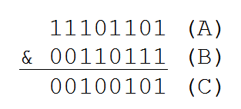
AND, OR, XOR
The bitwise AND operator
Denoted A & B = C, where A, B and C are integral types
Returns a new integer where the ith bit in C is set if and only if the ith bit in A and B are both set
Truth table
A | B | A & B
0 | 0 | 0
1 | 0 | 0
0 | 1 | 0
1 | 1 | 1

Slide 36
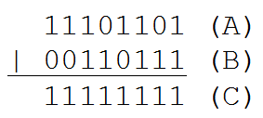
AND, OR, XOR
The bitwise inclusive OR operator
Denoted A | B = C, where A, B and C are integral types
Returns a new integer where the ith bit in C is set if either of the ith bits in A and B are set, or both
Truth table
A | B | A | B
0 | 0 | 0
1 | 0 | 1
0 | 1 | 1
1 | 1 | 1
OR operator

Slide 37
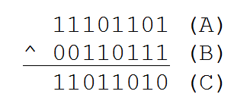
AND, OR, XOR
The bitwise exclusive OR operator
Denoted A ^ B = C, where A, B and C are integral types
Returns a new integer where the ith bit in C is set if either of the ith bits in A and B are set, but not both
Also called XOR
Truth table
A | B | A ^ B
0 | 0 | 0
1 | 0 | 1
0 | 1 | 1
1 | 1 | 0

Slide 38
Masking techniques
Bit mask: an integer used to select or alter a set of bits in another number
Selection:
Is the ith bit set in a binary number?
Technique
Create a mask (an integer) with only the ith bit set
00000100
Use the AND operator to determine if the bit is set
number & 00000100 = result

Slide 39
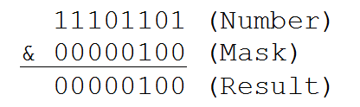
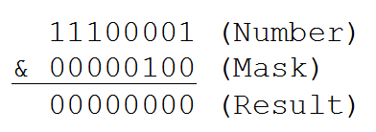
Selection
Example
Is the third bit set in the number -19? Or in -31?
What question do I need to ask to determine if the bit is set or not?

Slide 40

Assignment
Assignment:
Set the ith bit in a binary number
Technique
Assign the ith bit the value one
Create a mask with only the ith bit set
Use the OR operator to assign the bit
number | 00000100 = result
unchanged bits

Slide 41

Assignment
Technique
Assign the ith bit the value zero
Create a mask with all bits set except the ith bit
Use the AND operator to assign the bit
number & 11111011 = result
unchanged bits

Slide 42




Masking groups of bits
You can create a mask for any group of bits
Masking the left and right nibble
Other masks

Slide 43
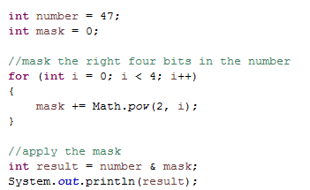
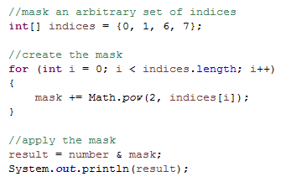
Creating masks
For each bit set in the mask, add 2^{i} to the mask, where i is the index of the bit
00001111 → 2³ + 2² + 2¹ + 2⁰
11110000 → 2⁷ + 2⁶ + 2⁵ + 2⁴

Slide 44
Bit shifting
Java has three bit-shifting operators
Shift left: <<
Shift right: >>
Unsigned shift right: >>>
Format:
binaryNumber << numberOfBits
eg. 00000111 << 2

Slide 45
Shifting left
Shifting left moves all bits in a binary number to the left
00000111 << 2 = 00011100
Bits shifted beyond the finite number of digits are lost
00111100 << 4 = 11000000
Shifting can change the sign of our number!
Each shift to the left multiplies our number by 2
00000011 << 1 = 00000110
3 << 1 = 6

Slide 46
Shifting right
Shifting right moves all bits in a binary number to the right
0101000 >> 3 = 00000101
Each shift divides our number by 2
40 >> 3 = 5
Sign extension: maintains the leftmost bit value during a right shift
11000000 >> 1 = 11100000
10111000 >> 3 = 11110111
The unsigned right operator does not use sign extension
11000000 >>> 1 = 01100000
10111000 >>> 3 = 00010111

Slide 47
Floating point numbers
Java has two floating point types
float and double
Defined by IEEE 754 standard
Values supported by IEEE 754 standard (and Java)
Negative infinity
Finite negative values
Negative and positive zero
Finite positive values
Positive infinity
NaN: not a number
Notes:
IEEE, Institute of Electrical and Electronics Engineers

Slide 48
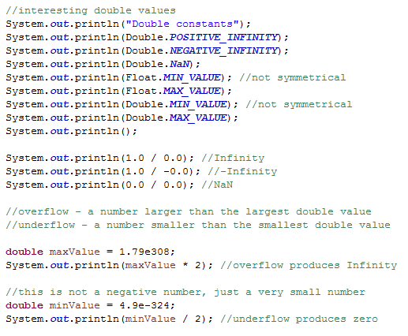
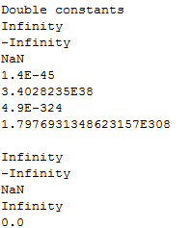
Testing Java’s floating point numbers

Slide 49
Representing Information
IT 301

